Slide 1

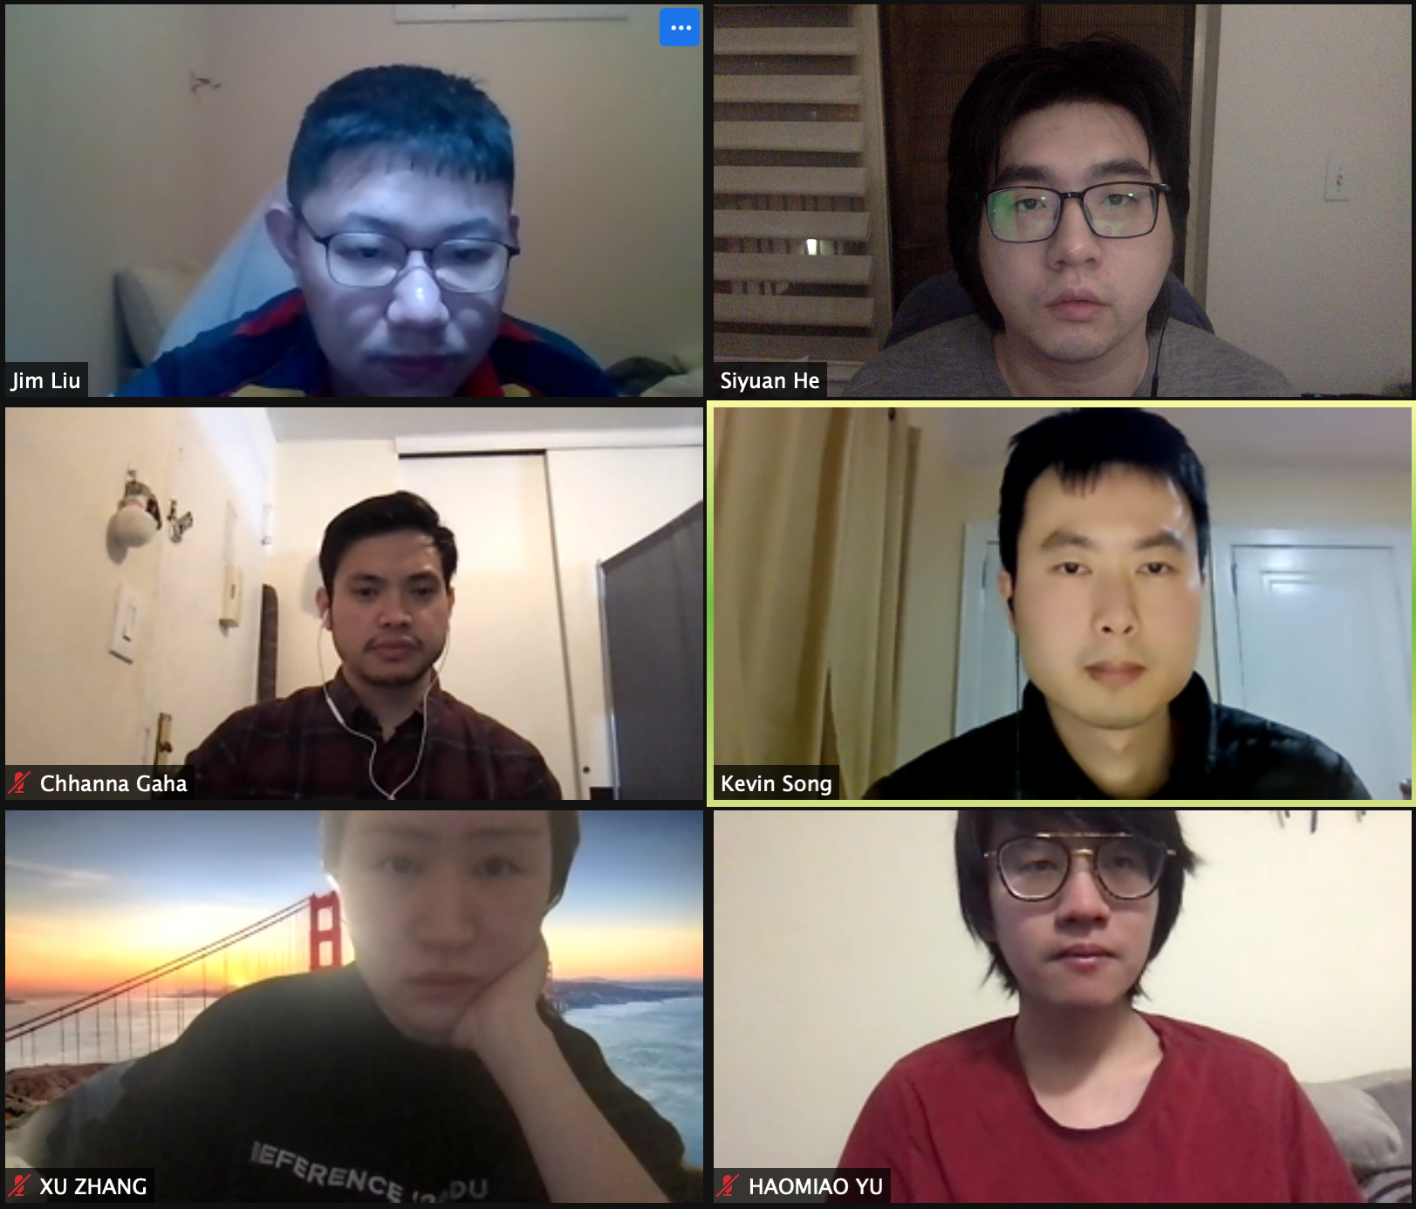
PC builder web application
Team member:
Kevin Song
Siyuan He
Xu Zhang
Haimiao Yu
Chhanna Gaha
Sichao Liu
Guided By: Professor Henry Wong
Deliverable VI
Team Name: Dice

Slide 2

Introduction
A new application is made if a developer produces a new idea or when there is new technology to create better software. Our team viewed many existing online PC hardware stores, they are either created with older development tools or lacking functions that we need nowadays.
Therefore, we are here with a web application that is developed using React and other advanced technologies to achieve smooth browsing and satisfying functionality. This web app will guide students and users who have less experience on PC hardware to pick the right parts. Also, it will help experienced PC shoppers fulfill their dream of building their own pc.

Slide 3
Persona of a college Student
Hi, I am Nancy studying Bachelor's in Computer Science at North Georgia University. It’s difficult for me to pick a laptop out of many brands. There are ASUS, MSI, Dell and so many famous brands with similar hardware specs. I wish there is a good online application to help me identify which brand has the best hardware with the best price.

Slide 4
Persona of a software engineer
Hi, I am Jz Han. I am an experienced IT worker living in the Georgia suburb. In Georgia, the retail store is far away from where I live so I always shop for PC parts online. However, the websites that I am familiar with are only office related. They do sell PC hardware but it’s not their major business. I wish there was a web application that would just focus on selling PC parts. It would need to have a clear category breakdown and run smoothly just like any other shopping website.

Slide 5
Persona of a FilMmaker
Hi, my name is Mark. I’m an MFA of Filmmaking in the School of Visual Arts in New York. Next semester I will take classes related to video editing and color correction and I’m using 4K videos instead of 1080p videos. So I’m changing my main editing tool from Adobe Premiere to Davinci Resolve. I have a great Gaming Desktop and it worked well with Premiere, but after moving to Davinci it runs much slower. I was told that different professional software sometimes make more use of different components of the PC. When I was trying to find which part of my PC should be replaced, I found that all the current PC building websites separated their PC builds into categories like gaming PC, creator PC, or office PC. It would be helpful to have a PC Building website which can make buying suggestions based not only on the main use, but also based on the specific workflow and tools.

Slide 6
Persona of a Gamer
Hi, I am Jessi, a Bachelor at Pace University. I’m a big fan of AAA PC gaming so I plan to buy a powerful laptop which can be used for heavy gaming as well as course work. The existing PC websites only show the specs of the laptops. However, the gaming performance is not only related to the specs on the laptop. The thermal strategy, TDP settings, power management, and even pre-installed software will affect the gaming performance in the real world. These detailed information are not shown on existing websites. It would be great to have a website to show me the real gaming performance of each laptop to help me make purchase decisions.

Slide 7
MVP
Which problem does it solve?
For the customers who are not familiar with the computer specs and components, it is difficult to choose the right PC builds or laptops that meet their needs.
Minimum:
A tool that helps customers build their own PC quickly and easily.
Viable:
A tool that helps customers set up their own PC quickly and easily. For customers without computer-related knowledge, it allows them to pick the right hardware for their needs. Customers can provide their working software information, budget, and expected years of use to get hardware recommendations. After selecting your PC build, you can either purchase the hardware directly from the website or pay a service fee and have it installed and delivered to you.
Minimum + Viable:
A tool that allows customers to select the right PC build for them while balancing budget and performance.

Slide 8
Comparison sprint 5 vs 6
Sprint 5
We completed User Profile design including
Display User Profile
Create user details api
display user information
Update user profile’s Page
Create user update api
update user info (fail due to a database error)
Since the update function fail, our team met ¾ = 75% of the commitment.
Sprint 6
We fix the “update user info” error in SPRINT 5
We completed Admin product management view
List Product
Create product list screen
Display products form
Create Product
Build create product api
Finish the code for create product button
Build Product Edit Page
Create edit button and its page
Code function to load product details
Update Product (fail)
We manage to write code for update product; however, it refuse to give right result. So, our team met 75% commitment again.

Slide 9
What we plan in SPRINT 7
We plan to finish coding admin’s product management page. The edit issue will be fixed ,also admin will finally be able to upload product image.
Then our team will start to implement admin’s user management page and all it’s function.

Slide 10
Product Backlog
Story ID | Sprint | User type | I want to be able to… | So that … | type | status
1 | I | Developer | Install development tool | Team can start writing the app
2 | I | Developer | Design Website Template | Team can plan on HTML, CSS
3 | I | Developer | Install communication platform | Team members are free to communicate
4 | II | User/Admin | Have a website | I can view/order items, create profile… | story | done
5 | II | User/Admin | Visualized Product Components | I can display images and their info on website | story | done
6 | II | User/Admin | Have detailed Product Page | I can click on product to check their detail | story | done
7 | II | User | Have Shopping cart | I can check purchased product | story | done
8 | III | User/Admin | Register | I can use my profile to perform such as buying…. | story | done
9 | III | User/Admin | Login/Log out securely | My account is private | story | done
10 | III | User | Display added items on cart icon | I can see number of items in cart | story | done
11 | III | User/Admin | Edit qty of item in both product and check out page | I can freely edit item numbers. | story | done
12 | IV | User | Enter name and shipping address | I can have name and shipping stored in profile | story | done
13 | IV | User | I want to check out and have an order number | I can wait for my order | story | done
14 | IV | Admin | I want to see order placed by customer | I can send order by shipping address | story | done

Slide 11
Product Backlog 2
Story ID | Sprint | User type | I want be able to … | So that… | type | status
15 | V | User | Have profile displayed | I can see my profile | story | done
16 | V | User | Update my profile info | I can freely edit profile and save | story | done
17 | V | Admin | List Product | I can see all order in list | story | done
18 | VI | Admin | Create Product | I can create product on website | story | done
19 | VI | Admin | Update Product | I can edit product info on website | story | In work
20 | VII | Admin | Upload Product Image | I don’t have to upload image manually | epic | In work
20 a | VII |  | Define upload router |  | task | In work
20 b | VII |  | Create uploads folder |  | task | In work
20 c | VII |  | Edit code in frontend |  | task
21 | VII | Admin | List Users | I can list users out and check them | story
22 | VII | Admin | Delete Users | I can remove unwanted user | story
23 | VIII | Admin | Edit Users | I can change user’s info as needed | epci
23a | VIII |  | Build api for update users |  | task
23b | VIII |  | Create edit screen UI |  | task

Slide 12
Product Backlog 3
Story ID | Sprint | User type | I want be able to … | So that… | type | status
24 | VIII | Seller | Have a seller page | I can list product for sale as a user | story
25 | VIII | Everyone | Deploy website | Website is good to use | story

Slide 13
Sprint 6 Test Case
ID | Process | Test Case | Description | Status | Expected Result | Actual result
18 | Create Product | Click on Create Product Button | Login as admin | Passed | Current user should replace by admin user | Admin user successfully logged in.
 |  |  | Move mouse to admin icon and when drop down menu show up, click on products button | Passed | Products page showed up | Products page showed up
 |  |  | Click on Create product Button | Passed | A sample product added | Sample product successfully added.
16 | Update Profile | Click on update button | In user profile page, fill in different user info and click update | passed | User should have new info record in database and display correct name on icon | User profile successfully updated.
19 | Update Product | Click on edit Button in product page | Login as admin. Within the product page, click any product’s edit button | Fail | A form show up with correct product info, and admin can edit them. | Data base error _id undefined.

Slide 14




Technologies we used

Slide 15
Sprint backlog
Story ID | Sprint | User type | I want be able to … | So that… | type | status
20 | VI | Admin | Update product | I can edit product info on website | story | Error
21 | VII | Admin | Upload Product Image | I don’t have to upload image manually | epic | In work
21 a | VII |  | Define upload router |  | task | In work
21 b | VII |  | Create uploads folder |  | task | In work
21 c | VII |  | Edit code in frontend |  | task | Rq 21 a
22 | VII | Admin | List Users | I can List user out and check | story
23 | VII | Admin | Delete Users | I can remove unwanted user | story
24 | VIII | Admin | Edit Users | I can change user’s info as needed | epic
24 a | VIII |  | Build api for update users |  | task
24 b | VIII |  | Create edit screen UI |  | task
25 | VIII | Seller | Have a seller page | I can list product for sale as a user | story
26 | VIII | Everyone | Deploy website | Website is good to use | story

Slide 16
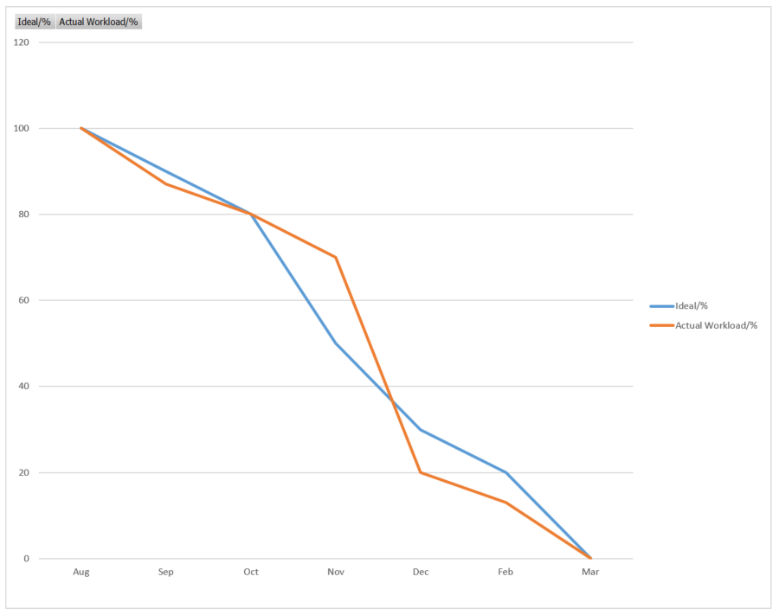
BURNDOWN CHART

Slide 17

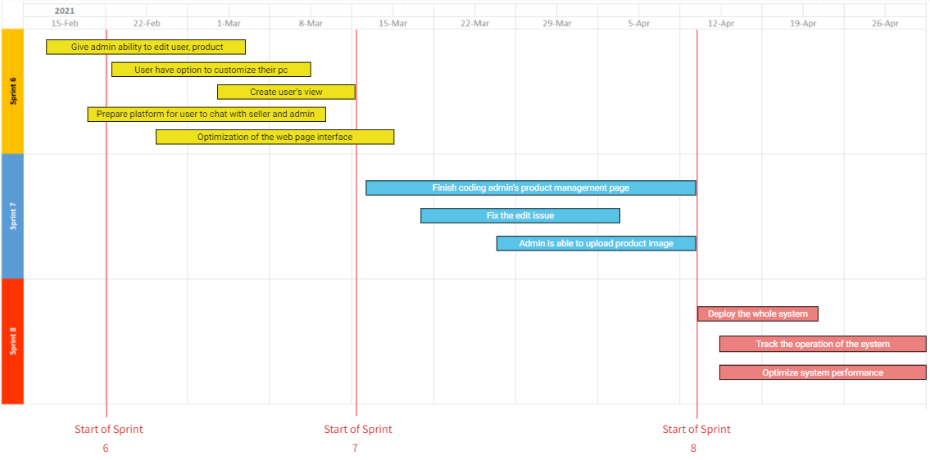
Project Timeline

Slide 18

Retrospectives
1.What went well
Group meeting frequently ensure we have a good time management
Good code progress
2.What needs improvement
Give more focus on agile and reflect its concept on our pptx.
Catch coding error while writing it, do not finish coding then come back.
3.Next step
Prepare for website deploy

Slide 19

GitHub link
https://github.com/ksong227/CS691TeamDice
Thank You

